Slide 1
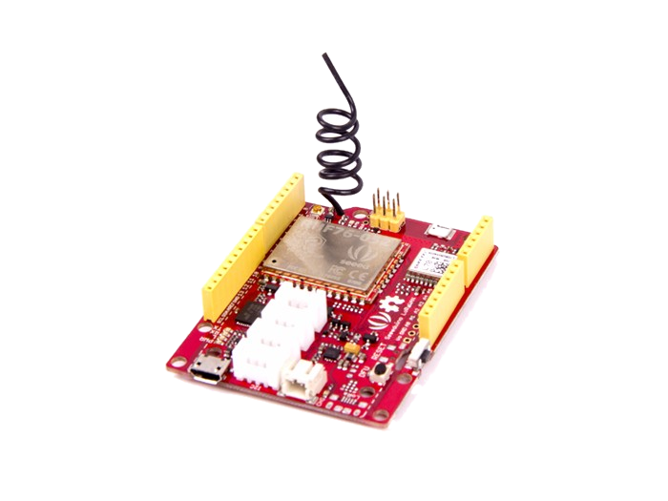
Seeeduino LoRaWAN
Experience LoRa’s advantage
in the field of IoT
Michele La Malva Moreno

Slide 2
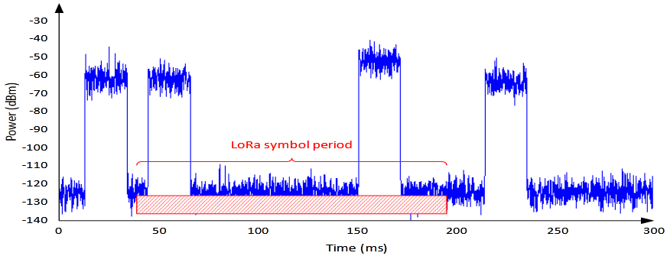
LoRa : Technology
LoRa is the type of radiofrequency modulation patented by Semtech and among its main advantages is:
High tolerance to interference and High sensitivity (-168dB)
Based on FSK modulation
Low consumption
Long range 10 to 20km
Low data transfer (up to 255 bytes)

Slide 3
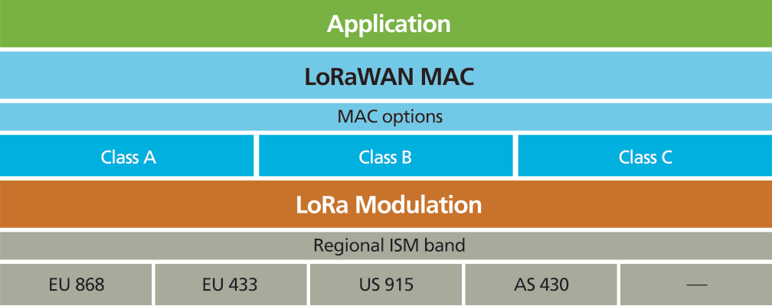
LoRaWAN : Protocol
LoRaWAN is a network protocol that uses LoRa technology to communicate and manage LoRa devices, it consists of two parts mainly: gateways and nodes.
Star topology
AES 128 Encryption
Support 3 Types of nodes
Public and Private networks
Device Management

Slide 4
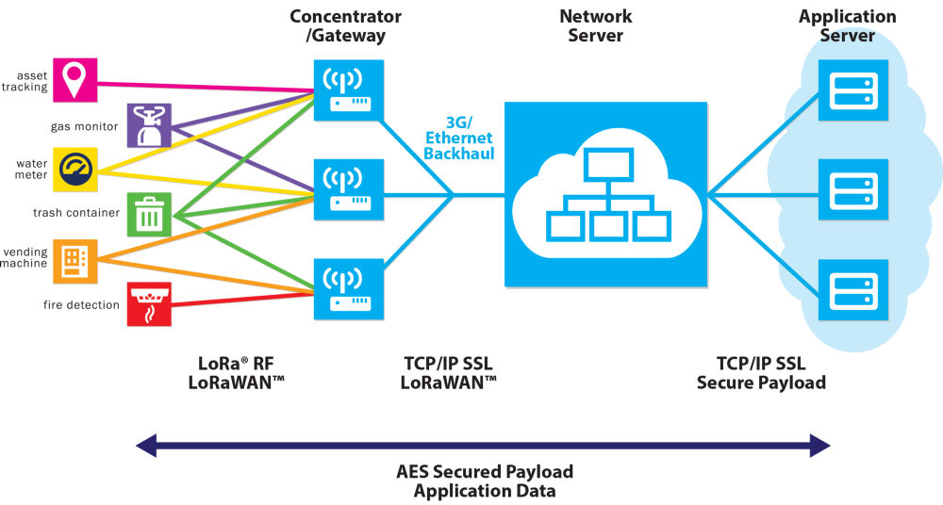
LoRaWAN : Structure

Slide 5
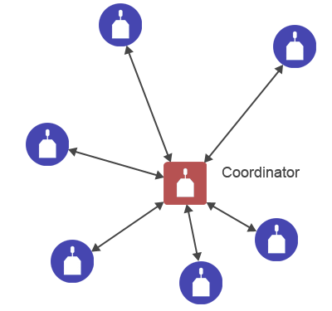
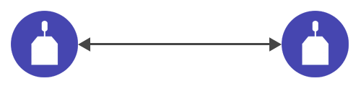
LoRaWAN : LoRa mode
In point-to-point connection (P2P) mode, a gateway device is no needed.
Instead, they can transmit information each others directly.
Point-To-Point connection
Mesh structure connection

Slide 6
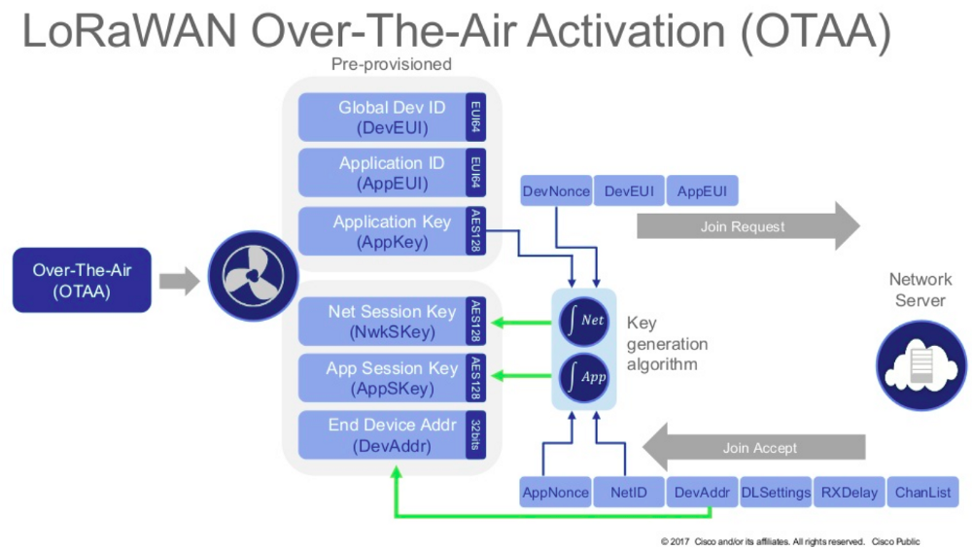
LoRaWAN : LoRaWAN OTAA mode

Slide 7
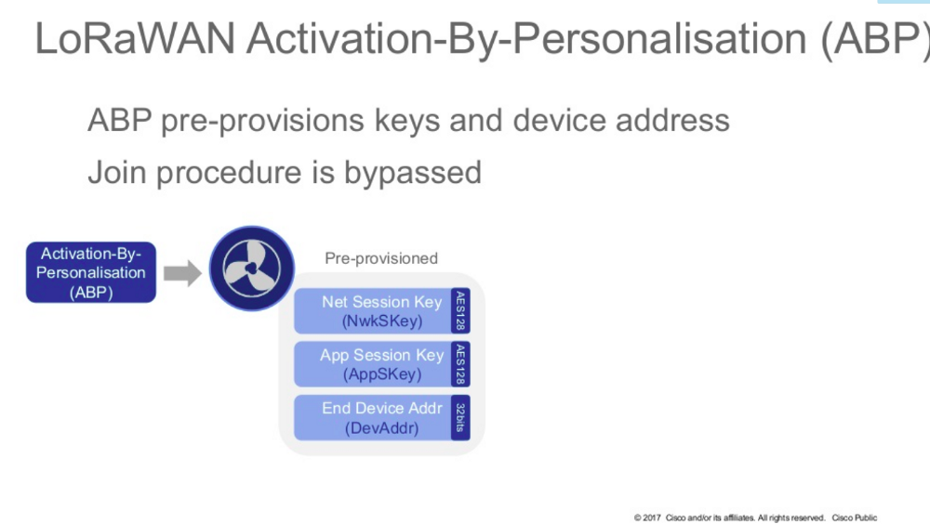
LoRaWAN : LoRaWAN ABP mode

Slide 8
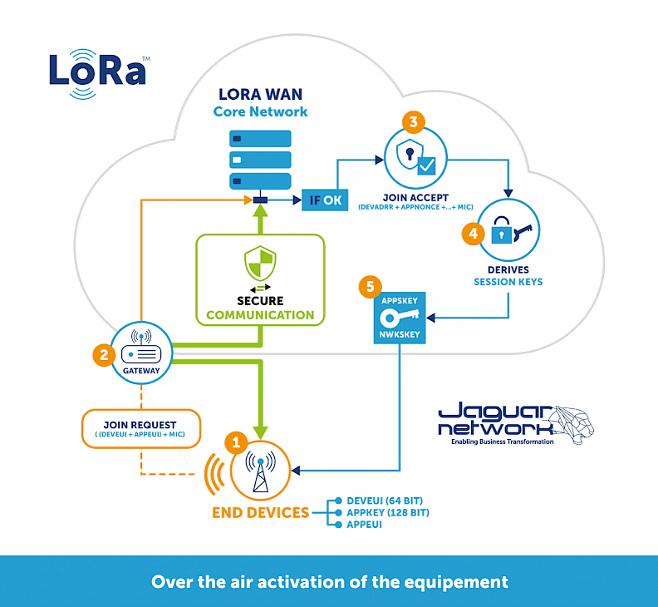
LoRaWAN : LoRaWAN OTAA / ABP mode

Slide 9
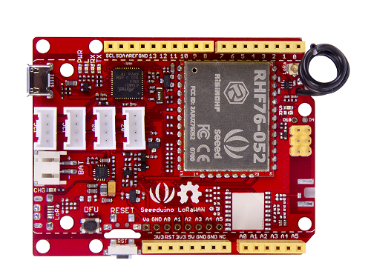
Seeeduino LoRaWAN : Board/Processor
ATSAMD21G18 (32-bit ARM Cortex M0+) @ 48MHz with 3.3V logic/power
Embedded with lithium battery management chip and status indicator led
20 GPIOs (All pins but 2 and 7 are PWM)
1 x analog output (10-bit DAC)
6 x analog inputs (12-bit ADC)
4 on-board Grove connectors
3.3V regulator with 200mA output
Flash Memory : 256 kb
SRAM : 32 kb
Device Firmware Upgrade button
Reset button

Slide 10
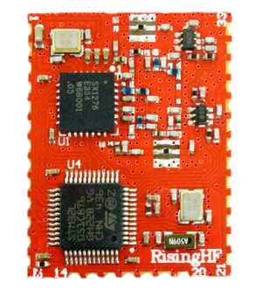
Seeeduino LoRaWAN : Board/Modules
RHF76-052AM LoRaWAN module embedded by SX1276 transceiver and MCU STM32L051/052XX.
High link budget of 160dB. -140dBm sensitivity and 19dBm Output power.
Support Class A/C LoRaWAN protocol
1.45uA sleep current in WOR mode
Dual band:
19dBm@434MHz/470MHz
14dBm@868MHz/915MHz
(Optional) GPS Chip L70B-M39

Slide 11
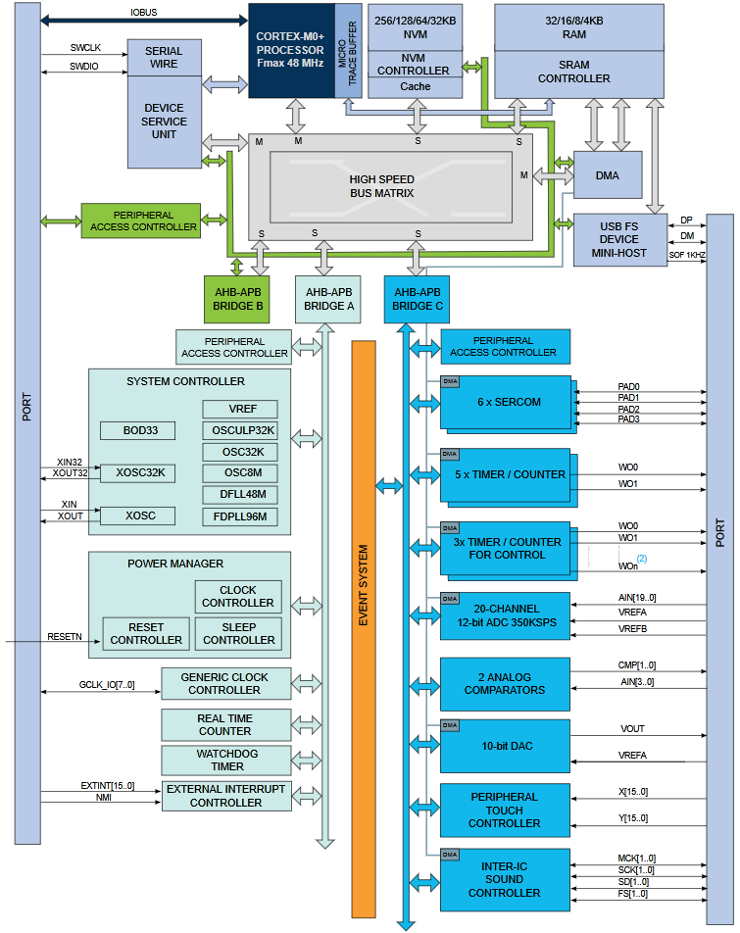
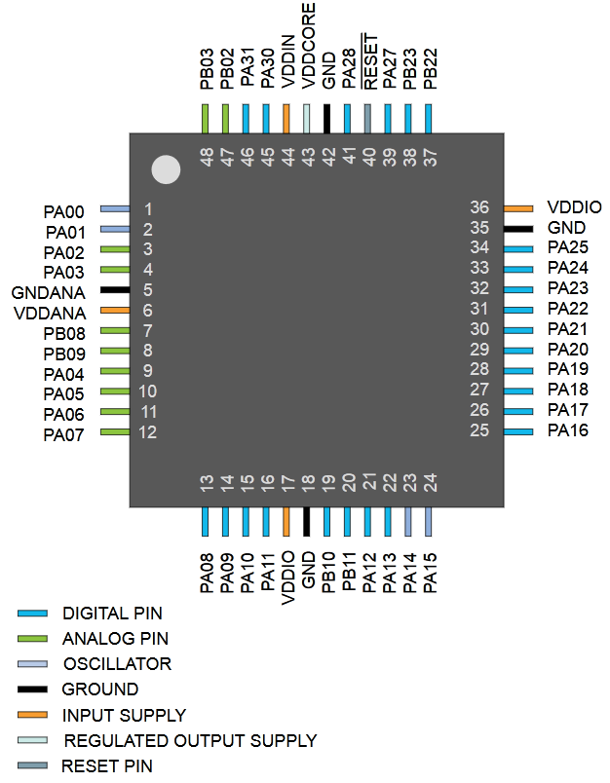
Seeeduino LoRaWAN : Block Diagram

Slide 12
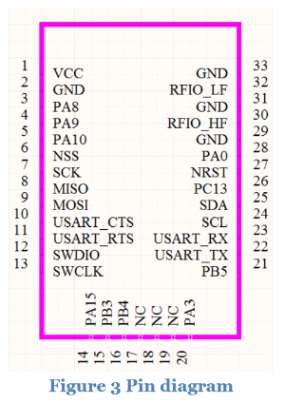
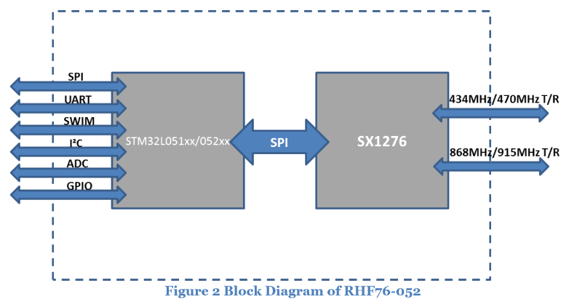
Seeeduino LoRaWAN : Block Diagram

Slide 13
Seeeduino LoRaWAN : In a nutshell
RHF76-52AM module
ATSAMD21G18
Processor
STM32L051/052XX
AT Commands
SPI
SX1276
SRAM, Flash, SERCOM...
Instructions
Gateways, LoRa Devices, etc..

Slide 14
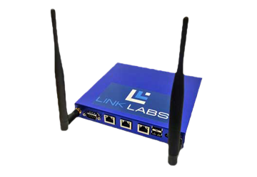
LoRa in Low-Power Wide-Area Network
Star topology

Slide 15
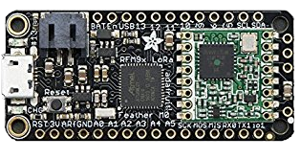
LoRa in Low-Power Wide-Area Network
Point to Point Connection
Seeeduino LoRa
Adafruit Feather 32u4 RFM95 LoRa

Slide 16
LoRa in LPWAN : Hands-On Example
What’s the value of pin A0?
Get A0 value
The value of A0 is X volts
Print A0 value
What’s your GPS-based position?
Get GPS position
My position is LAT/LON
Print position

Slide 17
LoRa in LPWAN : Hands-On Example
Master side
Init
Slave side
I’m a server
I’m a client
Ask an available
device a command
Wait for frame
Unknow message
or
it’s not for me
No response from client
(Time out)
2
0
Client answered successfully
Print the answer
Answer with
desired command
Server is asking me a command
3
1

Slide 18
LoRa in LPWAN : Hands-On Example
NOW LET’S FUN BEGIN!
And remember, If it works don’t touch it …

